Slide 1

JavaScript Advanced
Course Overview
SoftUni Team
Technical Trainers
Software University
http://softuni.bg

Slide 2
Table of Content
Introduction
Training & Team
Course Objectives
Course Organization

Slide 3
Have a Question?
sli.do
#JS-ADVANCED

Slide 4












SoftUni Diamond Partners

Slide 5




SoftUni Organizational Partners

Slide 6

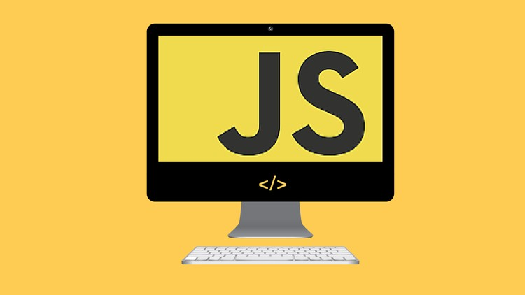
JS Advanced
Course Objectives & Program

Slide 7

JS Advanced - Course Topics
Syntax, Functions and Statements
Objects
Arrays
Advanced Functions - First-class function, higher-order function, partial and currying, IIFE
DOM
DOM Manipulations - Advanced DOM Manipulations

Slide 8
JS Advanced - Course Topics
6. JS Classes - Defining classes, structure
7. Unit Testing and Modules - Error handling, exception handling, concepts, mocha
8. Strings and RegExp
9. Workshop

Slide 9

Trainers and Team

Slide 10
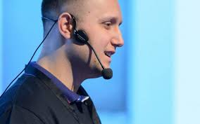
Martin Chaov
Technical Lead and Software Architect @ SBTech
Specialist in client software and JavaScript programming
His main task is to maintain and develop the SBTech end-user application architecture
This includes responsive web applications, PWAs, native apps and more

Slide 11
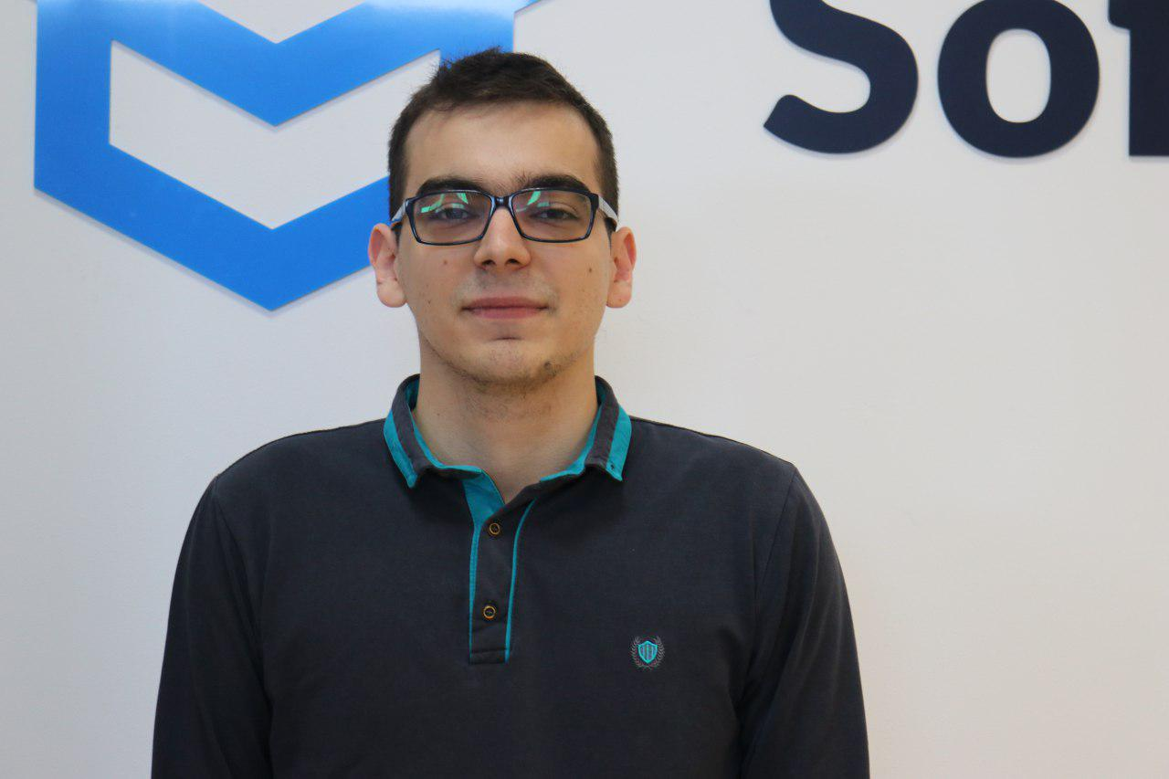
Kiril Kirilov
Team Lead @ SoftUni
Worked as a Front-End Developer
Passionate about .NET, JavaScript, Angular
Currently studying Math & Informatics at Sofia University (FMI)
Contacts:
k.kirilov@softuni.bg

Slide 12
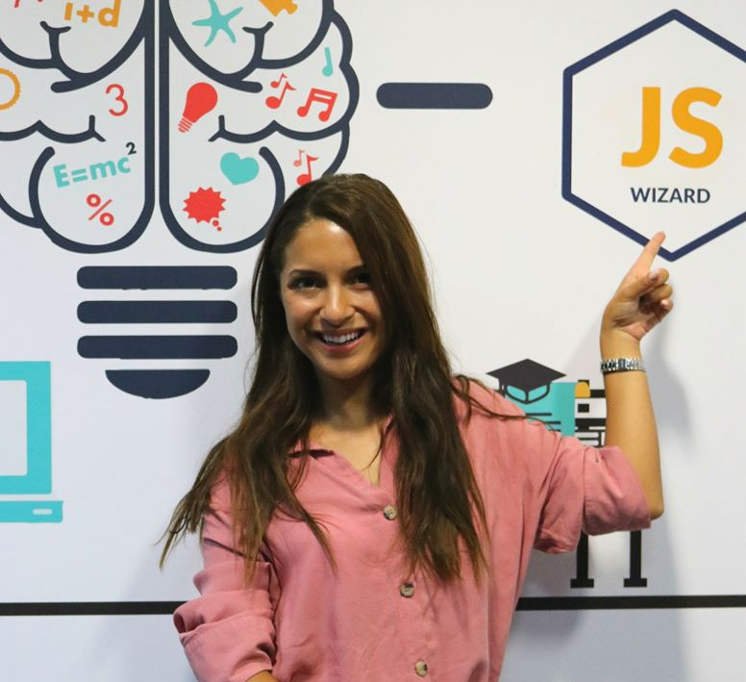
Antonia Atanasova
Passionate about Front-End Development
Program Lead JavaScript & Technical Trainer in SoftUni
Web Development Freelancer
Contacts:
a.atanasova@softuni.bg
http://antoniaat.com

Slide 13
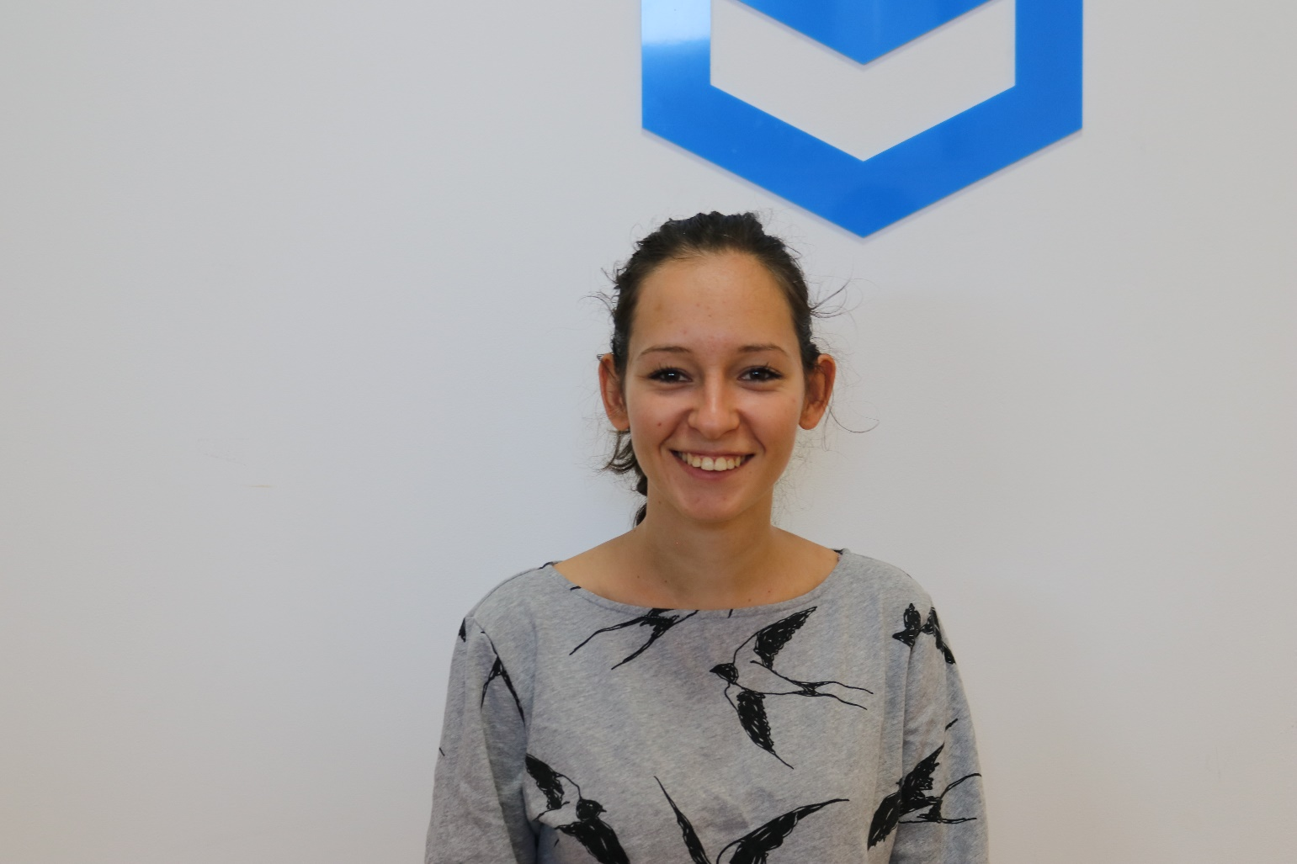
Mihaela Mileva
Experience in JavaScript, HTML, CSS, JAVA
Team Lead @ SoftUni
Currently studying Architecture in UACG
Contacts
mihaela.mileva@softuni.bg

Slide 14

Course Objectives
Course Details and Schedule

Slide 15
Targets of the Course
Advanced coding skills for the JS language
Extends the JS Fundamentals course
Covers: Arrays, Objects, Advanced Functions, DOM, Classes, Unit Testing , String Manipulations and RegExp

Slide 16

Practical Exam
Structure: 3 problems for 4 hours
Problems description:
DOM Manipulations
Unit Testing
Classes

Slide 17
Theoretical Exam
10 questions for 10 minutes
Multiple-choice with 1 correct answer
English
Automated quiz system
Available online the day before the practical exam
You can submit your answers just one time

Slide 18



Scoring System for the Course
Theoretical Exam 5%
PracticalExam 90%
Presence in class 5%
Evaluation
Homework 5 %

Slide 19

Course Organization

Slide 20

Evaluation Criteria
Mandatory
Practical exam - 90%
Theoretical exam - 5%
Exercises/Homework - 5%
Bonuses:
Presence in class – 5% bonus (onsite students only)

Slide 21
https://softuni.bg/courses/js-advanced

Slide 22




Trainings @ Software University (SoftUni)
Software University – High-Quality Education and Employment Opportunities
softuni.bg
Software University Foundation
http://softuni.foundation/
Software University @ Facebook
facebook.com/SoftwareUniversity
Software University Forums
forum.softuni.bg

Slide 23

License
This course (slides, examples, demos, videos, homework, etc.) is licensed under the "Creative Commons Attribution-NonCommercial-ShareAlike 4.0 International" license

